Slide 1
DASAN AGE
Dasan AGE produces its quart products to the highest standards of artistic excellence
2025. 4

Slide 2
Contents
1. Overview
2. Production Site
3. Key Products
4. Patents and ISO certification

Slide 3
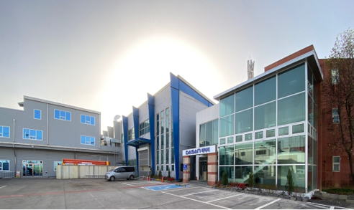
01. Overview #1
Date of establishment : November 14, 1997
Address : 213, Chupalsandan-ro 1-gil, Paengseong-eup, Pyeongtaek-si, Gyeonggi-do
Area : 5,000 m² of land, 3,500 m² of gross floor area
Business : Manufacture and sale of quartz glass products for semiconductor cleaning and etching equipment
ISO Certification: ISO 45001 / ISO 22301 / ISO 14001 / ISO 9001
Total number of employees : 77 (including 35 welders)
E-mail : dasan@ageng.co.kr
Homepage : www.ageng.co.kr

Slide 4
Vision
01. Overview #2
Vision
DASAN AGE contributes to the acceleration of the hyper-connected society by providing high quality
quartz products to industrial partners and innovating its manufacturing process.
Pursuit of creativity and innovation
Social Responsibility and Sustainability
Transparent Disclosure of Business Performance
Nurturing talents and pursuing employee satisfaction
Customer satisfaction is our top priority
Company Culture

Slide 5
01. Overview #3
Company History
2024
October Installed Torus Tube welding robot
June
Established the corporate research institute
May Patent Registration for Fire Polishing Method Using a Robotic Arm Launched 215kW solar power generation project
April Selected for Gyeonggi Province Advanced Smart Factory Support Program
2023
December Installed robotic arm-based polishing automation system, filed related patent
November
Developed and implemented the preliminary ERP and MES system
May
Established R&D department
April Changed company name from AGE to Dasan AGE
January
Chul-Hee Han Appointed as CEO by Dasan Group
2022
July
Dasan Group acquired AGE
2019
June Registered patent for automatic quartz sanding system
2018
December Surpassed 10 billion KRW in sales for the first time
2014
July Registered patent for quartz vacuum molding equipment
2006
June Changed company name from Korea Quartz to AGE (Advanced General Engineering)
2005
November
Registered design for quartz forming mold
2004
August Registered patent for vacuum chamber and its manufacturing method
2001
March
Selected as a Superior Technology Company (by Korea Technology Credit Guarantee Fund)
February
Relocated headquarters to Chupal Industrial Complex, Pyeongtaek, Gyeonggi Province
2000
October
Selected as a Promising SME (by Korea Credit Guarantee Fund)
1997
November
Established Korea Quartz in Songtan, Gyeonggi Province

Slide 6
01. Overview #4
Organization chart
CEO
Vice President
Plant Manager
R&D Center
Technical Sales Team
Accounting and Logistics
Quality Control Team
Production Management
MachiningTeam
(2 teams)
Welding Team
(3 teams)
Welding Support Team

Slide 7
01. Overview #5
Featured Clients
DASAN AGE is supplying the quartz glass products to semiconductor manufacturers and equipment companies. It also exports to Japan, the United States, Taiwan, and other countries, and has a competitive price compared to companies in the same industry.
Domestic Business
SAMSUNG
PSK
PSK HOLDINGS
DB HITEK
MEMC KOREA
ZEUS
KSM
KC TECH
SK HYNIX
NI WIN
MKS KOREA
Abroad Business
AGR (USA)
JET (JAPAN)
GLOBAL WAFERS (USA, JAPAN, TAIWAN)

Slide 8
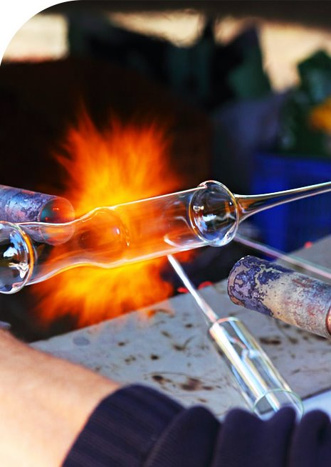
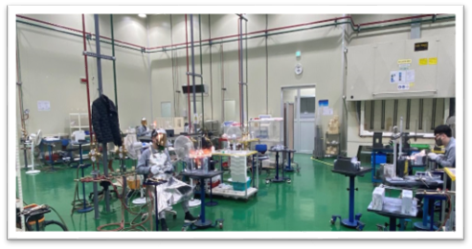
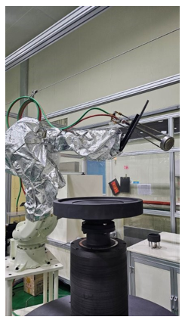
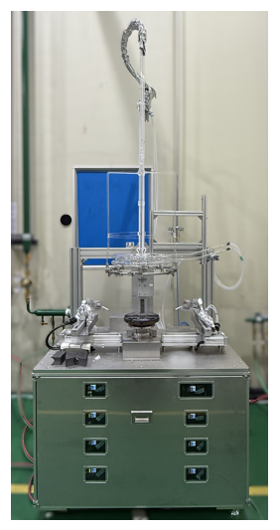
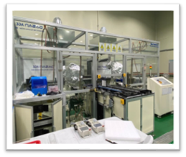
02. Production Site #1
The machining of quartz glass and the welding are at the core of DASAN AGE.
To prevent contamination of products by foreign substances, the welding room maintains the cleanroom class 5,000 or less.
Our company has introduced two robotic arms for fire polishing, one torus automatic welding machine and two vacuum forming robotic arms. Through this, we have expanded our production capacity and ensured uniformity in the heat treatment process.

Slide 9
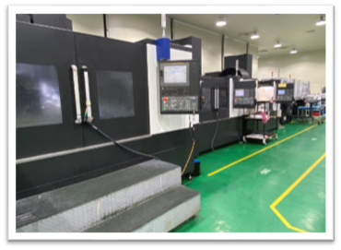
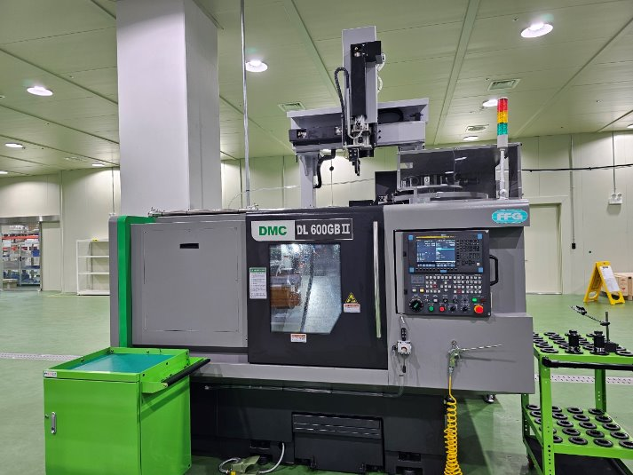
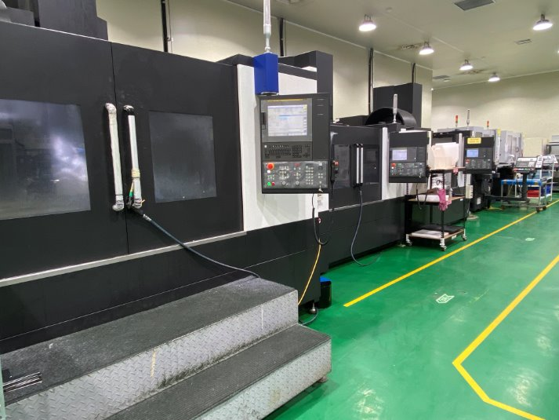
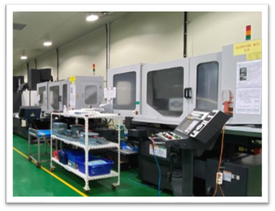
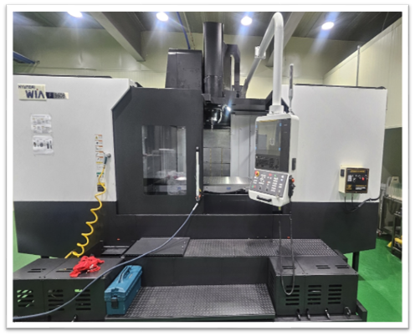
02. Production Site #2
DASAN AGE operates 9 MCTs, 2 Water Jets, 3 CNC Machines, and 2 Slotting Machines for quartz glass processing.
MCTs can process quartz glass up to 960 mm on the Y-axis.
CNCs can process quartz glass up to 600 mm in diameter.

Slide 10
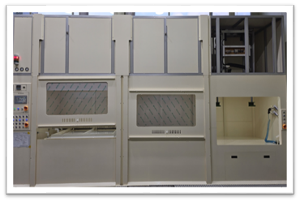
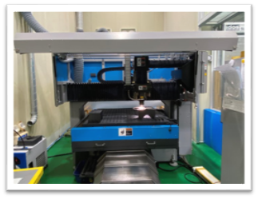
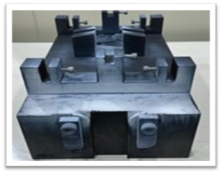
02. Production Site #3
DASAN AGE has one laser processing machine to perform precision machining of quartz glass parts with a thickness of 8mm or less.
We design our graphite molds in-house, which allows us to manufacture a wide range of products in the exact size to meet our customers' needs.
DASAN AGE uses hydrofluoric acid (HF) for quartz glass cleaning, and the hydrofluoric acid concentration and cleaning time are automatically adjusted.

Slide 11
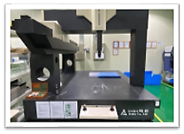
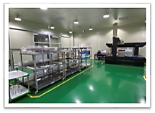
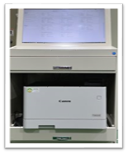
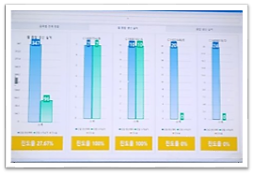
02. Production Site #4
We operate a quality control room with a cleanroom class of 2,000 or less, and use 3D measuring machines and large polarizers for product inspection.
We operate a manufacturing execution system (MES) to apply digitized production management, which allows us to understand the progress of work in the factory in real time.

Slide 12
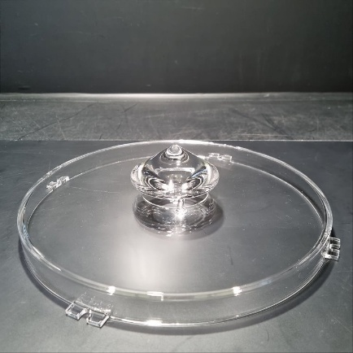
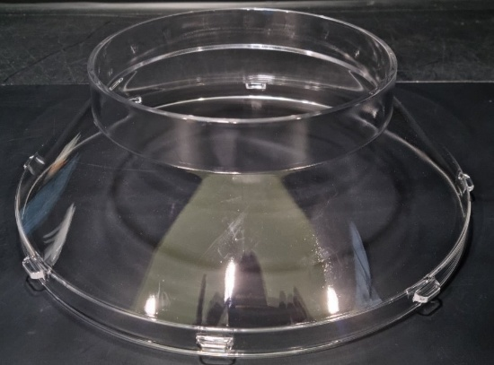
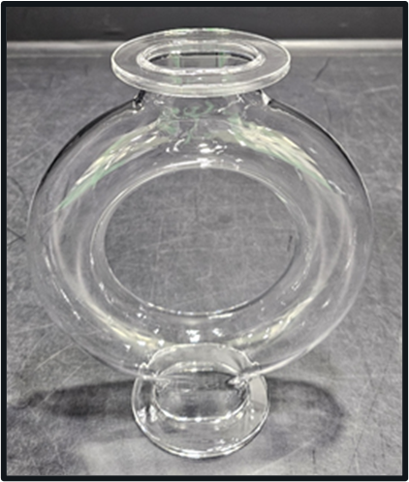
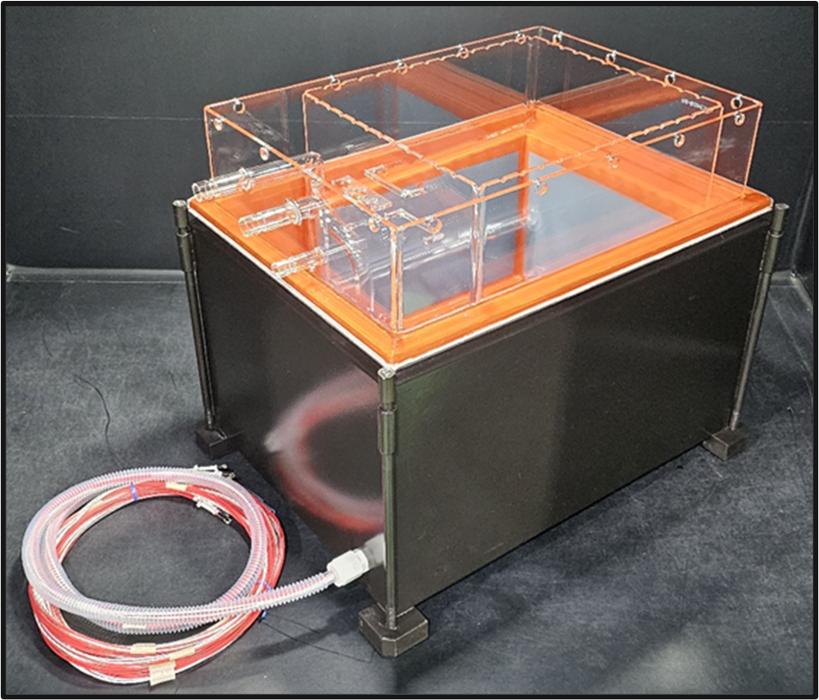
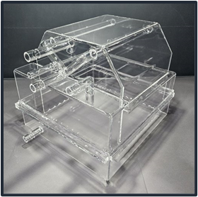
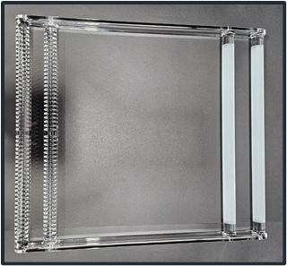
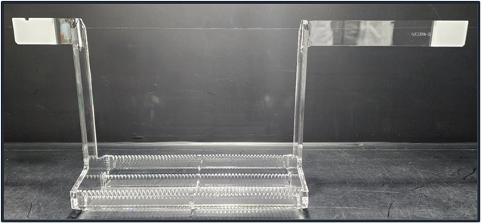
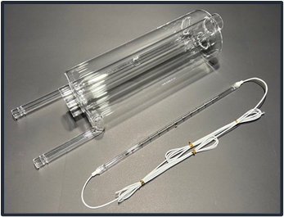
03. Key Products #1
Asher Parts
Focus Adaptor
Circular Tube
Wet-Station Parts
Heater Bath
Double Bath
Chuck
Guide
In-line Heater

Slide 13
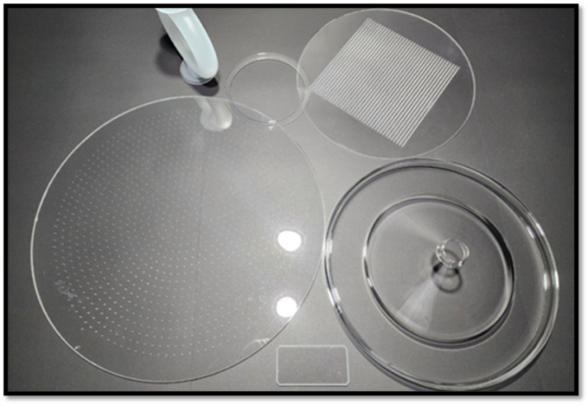
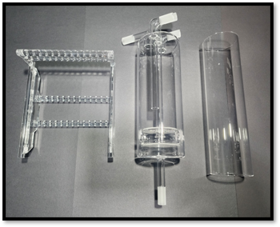
03. Key Products #2
Other Products
In addition to the aforementioned products, DASAN AGE can manufacture small and medium-sized quartz glass products used in semiconductor cleaning and etching processes in 1~2 months’ time

Slide 14
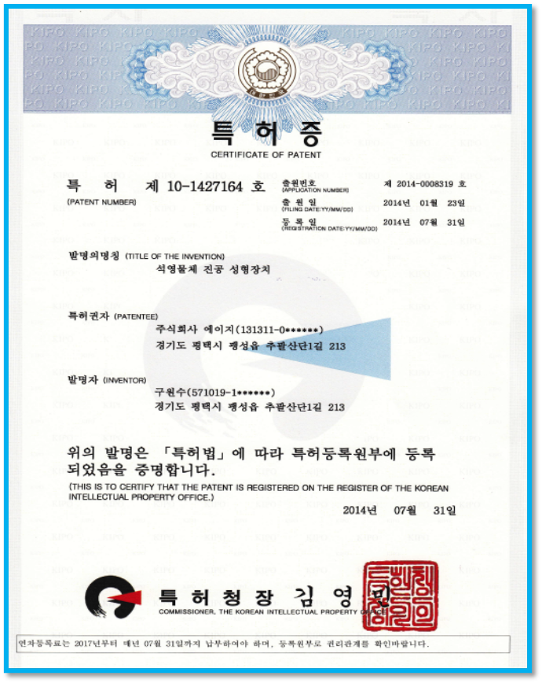
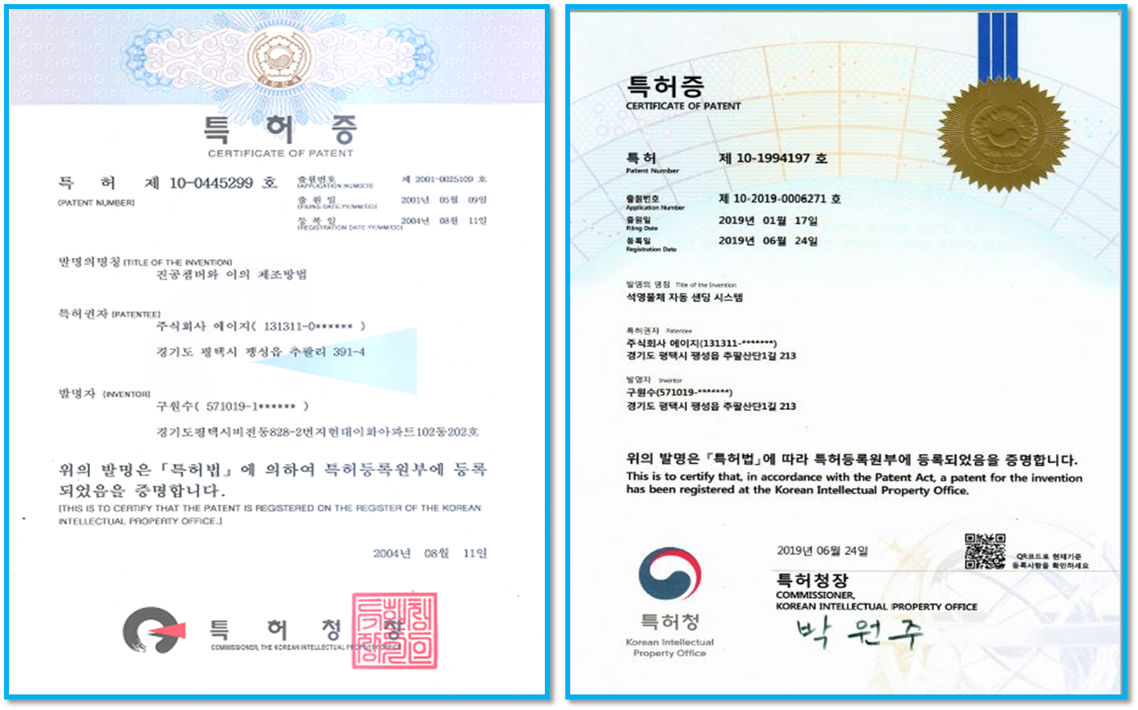
04. Patents & ISO Certification #1
Certificate of Patent​
Vacuum Chamber and Its Manufacturing Method (Registered in 2004)
Vacuum Molding Apparatus for Quartz Objects (Registered in 2014)
Automatic Sanding System for Quartz Objects (Registered in 2019)
Fire Polishing Method Using a Robot Arm (Registered in 2024)
Quartz Glass Processing System and Method Using a Robot (Registered in 2025)
Robotic vacuum forming to create quartz using robotics (Application filed in 2025)
Torus Manufacturing Method (Application filed in 2025)
Gas Flow Control System for Replacing MFC Using Individual Components (Application filed in 2025)

Slide 15
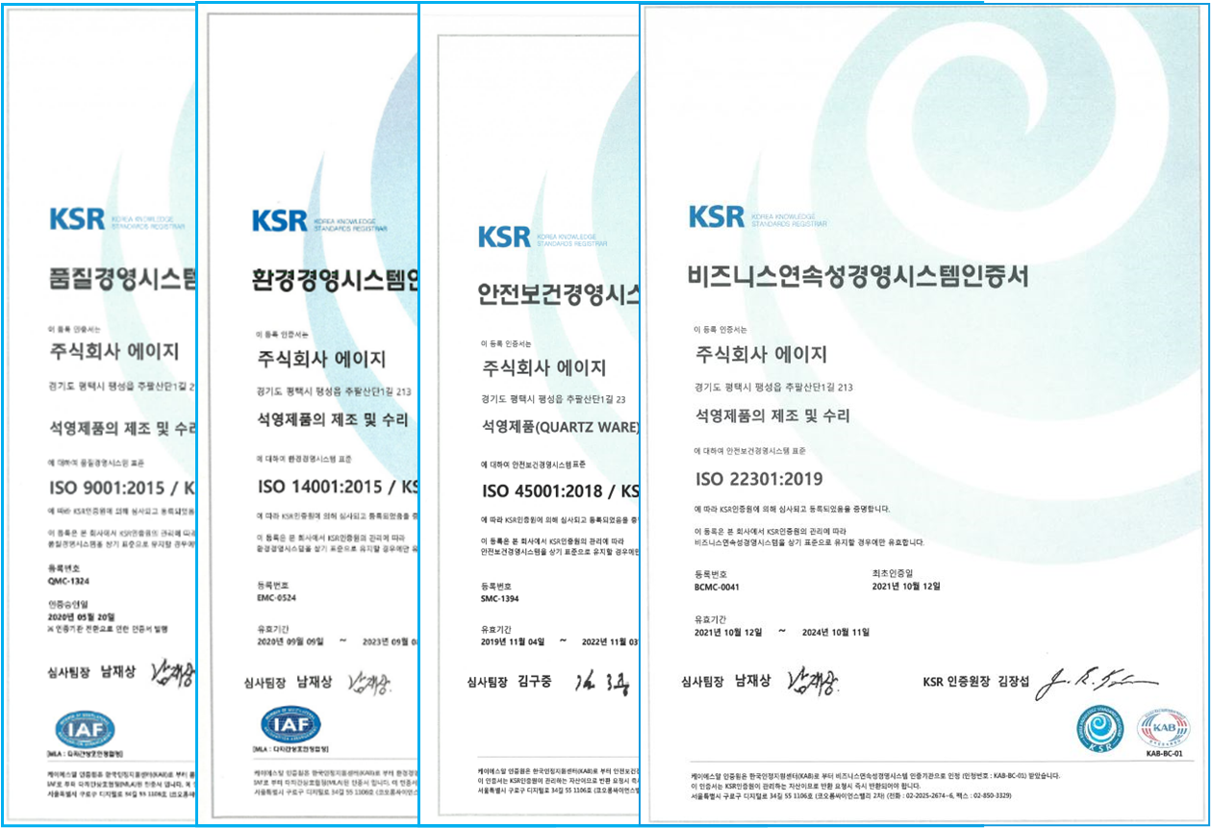
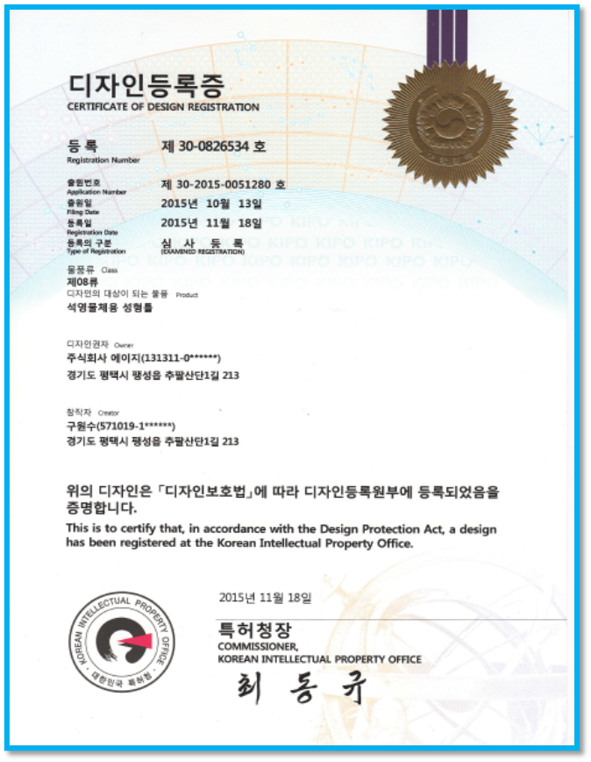
04. Patents & ISO Certification #2
ISO
Certificate of Design Registration
ISO 9001
ISO 14001
ISO 22301
ISO 45001
ISO 27001
ISO 50001
Quartz objects​ molding frame​ (Registered in '15)
To be certified

Slide 16
DASAN AGE
The company dedicated to customer satisfaction.

